Slide 1
Images and image filtering

Slide 2
Annoucements
No class on Monday (University holiday – Martin Luther King, Jr day)
Remember to complete Lecture 1 by tonight!
Textbook recommendation:
Burger & Burge, Digital Image Processing (available as online PDF through IU library website)

Slide 3
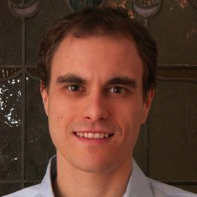

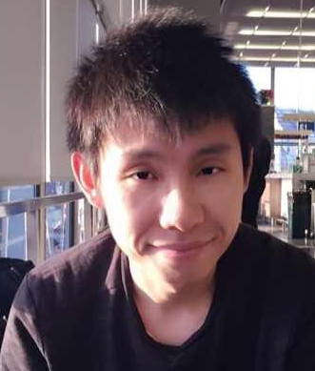
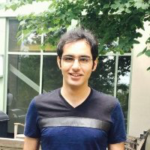
David Crandall
PhD, Cornell, 2008
Bardia Doosti
PhD student, IU
Yunsheng Yao
PhD student, IU
Ali Varamesh
PhD student, IU

Slide 4
Academic integrity
Read and understand the AI policy on syllabus
We will look for and prosecute AI violations
Be especially careful with homework assignments
You may discuss homework problems at a high level (e.g. general strategies for solving problems), but you may not share code, and you must cite the other student in your submission
If you use ideas or code from another source (like a webpage or textbook) you must acknowledge the source in your submission

Slide 5
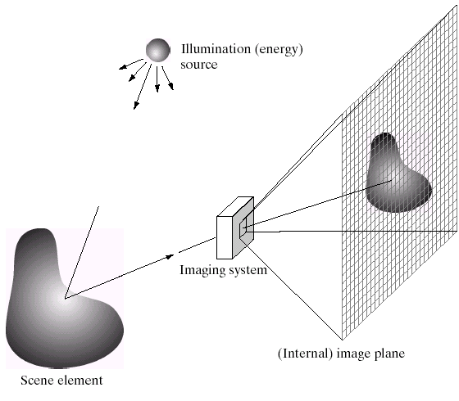
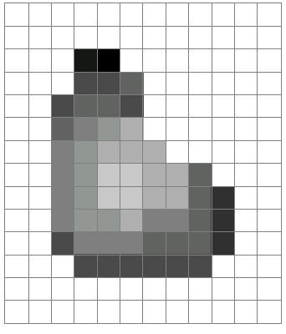
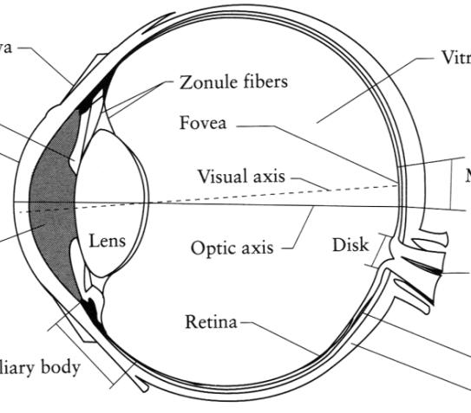
What is an image?
Digital Camera
The Eye
Source: A. Efros

Slide 6
What is an image?
A grid of intensity values
(common to use one byte per value: 0 = black, 255 = white)
255 | 255 | 255 | 255 | 255 | 255 | 255 | 255 | 255 | 255 | 255 | 255
255 | 255 | 255 | 255 | 255 | 255 | 255 | 255 | 255 | 255 | 255 | 255
255 | 255 | 255 | 20 | 0 | 255 | 255 | 255 | 255 | 255 | 255 | 255
255 | 255 | 255 | 75 | 75 | 75 | 255 | 255 | 255 | 255 | 255 | 255
255 | 255 | 75 | 95 | 95 | 75 | 255 | 255 | 255 | 255 | 255 | 255
255 | 255 | 96 | 127 | 145 | 175 | 255 | 255 | 255 | 255 | 255 | 255
255 | 255 | 127 | 145 | 175 | 175 | 175 | 255 | 255 | 255 | 255 | 255
255 | 255 | 127 | 145 | 200 | 200 | 175 | 175 | 95 | 255 | 255 | 255
255 | 255 | 127 | 145 | 200 | 200 | 175 | 175 | 95 | 47 | 255 | 255
255 | 255 | 127 | 145 | 145 | 175 | 127 | 127 | 95 | 47 | 255 | 255
255 | 255 | 74 | 127 | 127 | 127 | 95 | 95 | 95 | 47 | 255 | 255
255 | 255 | 255 | 74 | 74 | 74 | 74 | 74 | 74 | 255 | 255 | 255
255 | 255 | 255 | 255 | 255 | 255 | 255 | 255 | 255 | 255 | 255 | 255
255 | 255 | 255 | 255 | 255 | 255 | 255 | 255 | 255 | 255 | 255 | 255
=

Slide 7
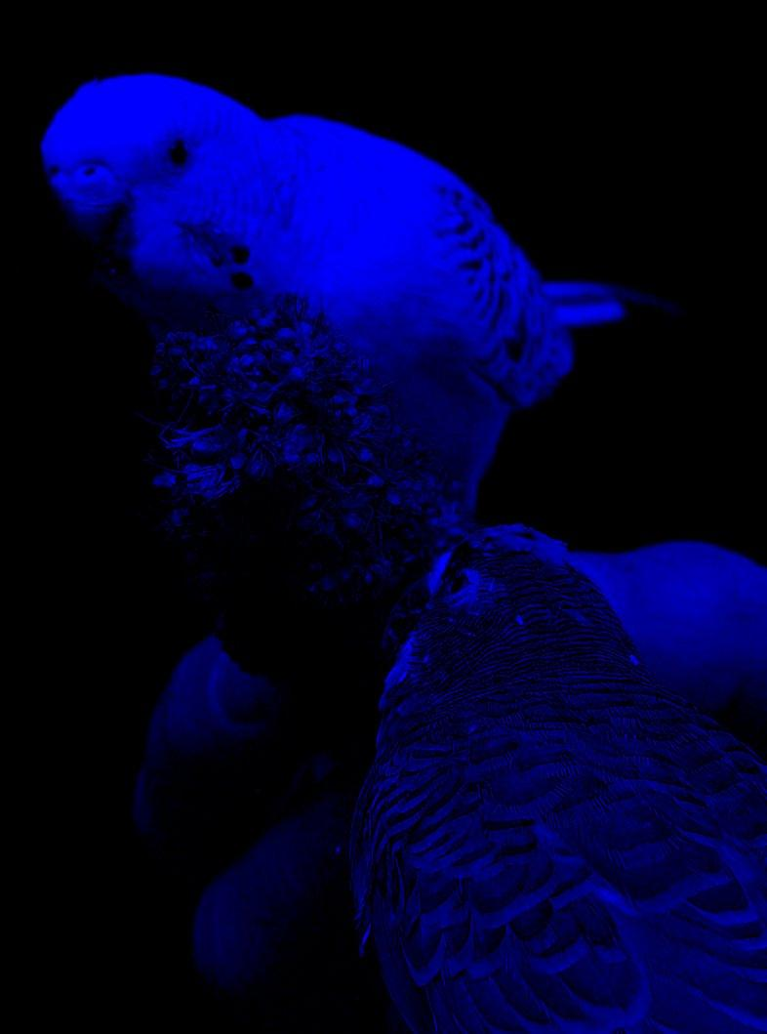
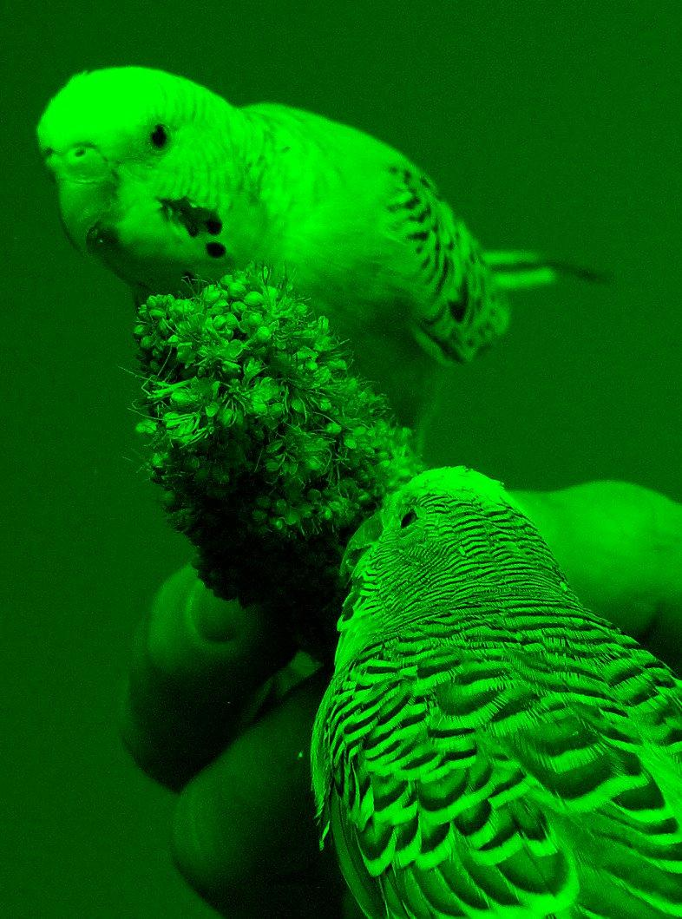
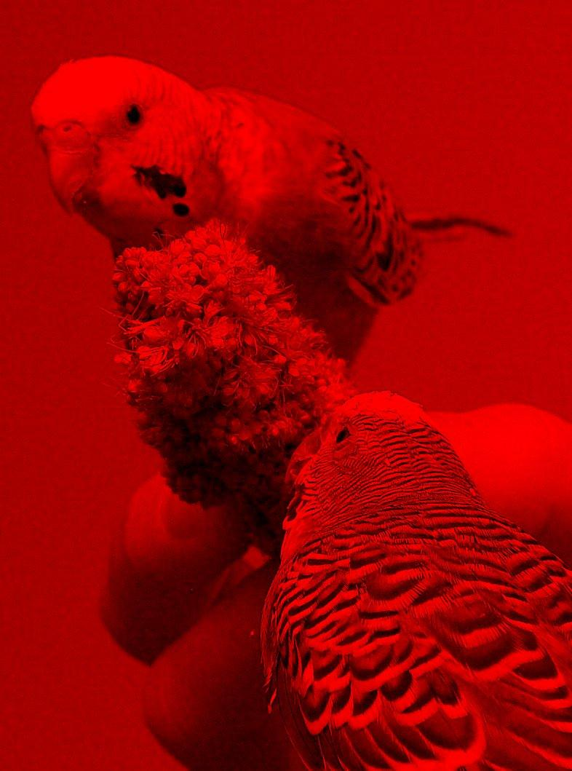
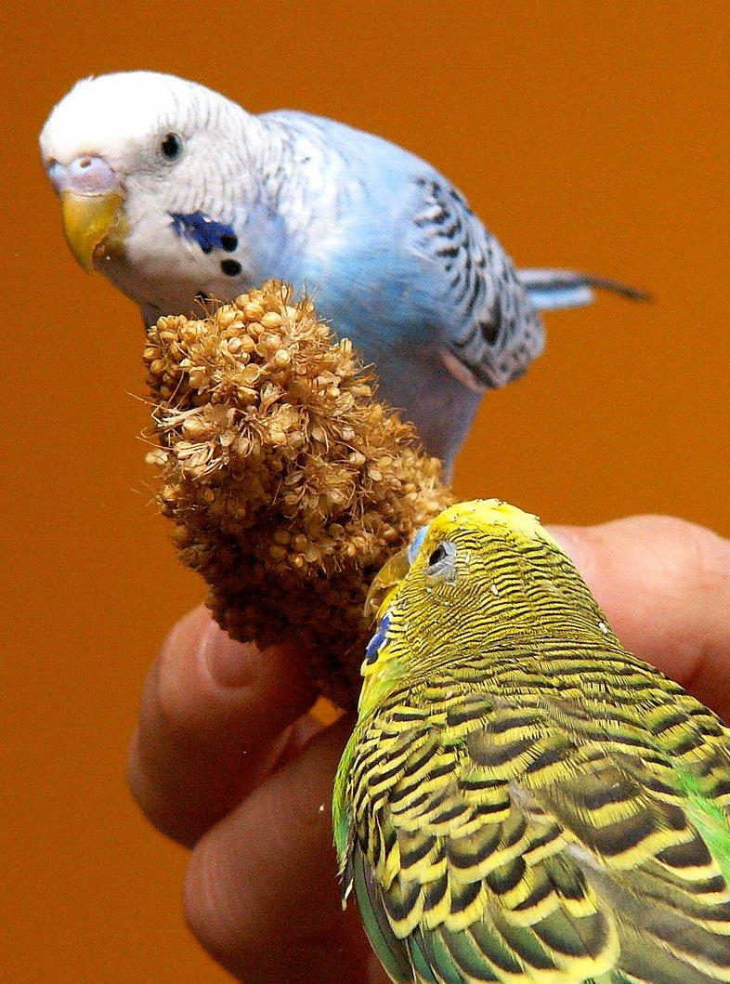
Red
Green
Blue

Slide 8
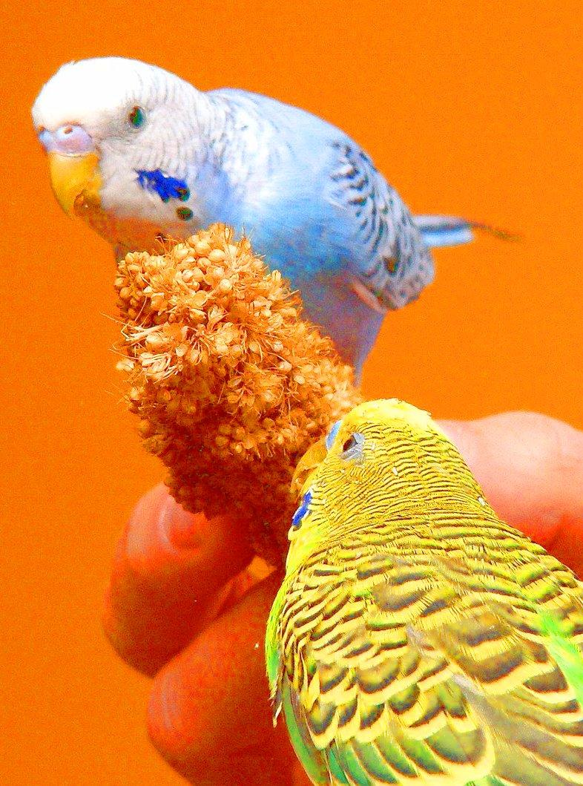
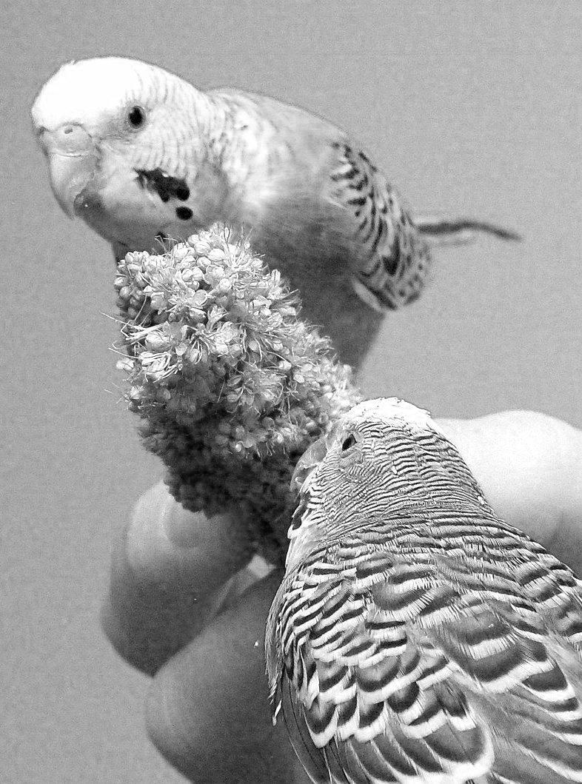
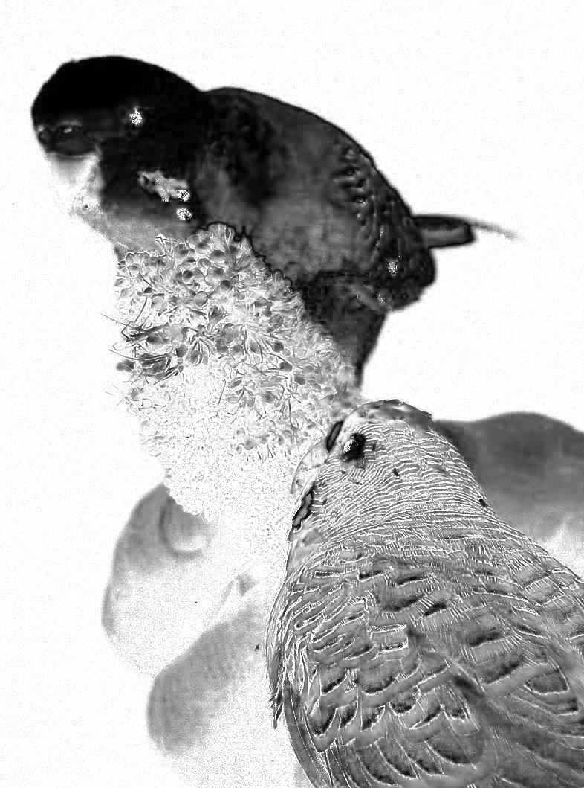
Hue angle
Saturation
Brightness

Slide 9
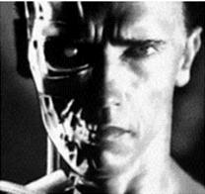
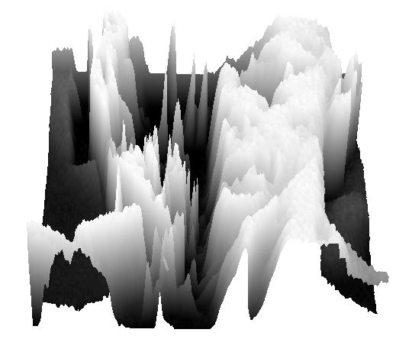
What is an image?
We can think of a (grayscale) image as a function, f, from R² to R:
f (x,y) gives the intensity at position (x,y)
A digital image is a discrete (domain is sampled, range is quantized) version of this function
f (x, y)
x
y
3D view

Slide 10
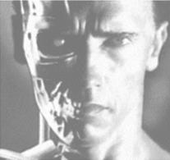
Image transformations
As with any function, we can apply operators to an image
g (x,y) = f (x,y) + 20
g (x,y) = f (-x,y)

Slide 11
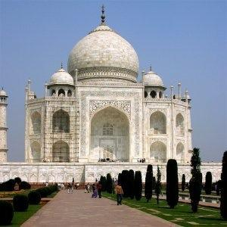
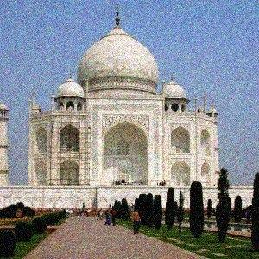
e.g. Image noise
Imaging systems (sensor, lens, compression algorithm, etc.) add unwanted noise

Slide 12
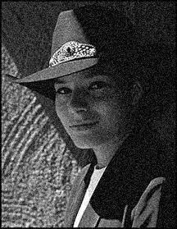
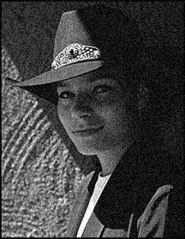

Question: Noise reduction
Given a camera and a still scene, how can you reduce noise?
Take lots of images and average them!
What’s the next best thing?
Source: S. Seitz
Notes:
Answer: take lots of images, average them

Slide 13
0 | 0 | 0 | 0 | 0 | 0 | 0 | 0 | 0 | 0
0 | 0 | 0 | 0 | 0 | 0 | 0 | 0 | 0 | 0
0 | 0 | 0 | 90 | 90 | 90 | 90 | 90 | 0 | 0
0 | 0 | 0 | 90 | 90 | 90 | 90 | 90 | 0 | 0
0 | 0 | 0 | 90 | 90 | 90 | 90 | 90 | 0 | 0
0 | 0 | 0 | 90 | 0 | 90 | 90 | 90 | 0 | 0
0 | 0 | 0 | 90 | 90 | 90 | 90 | 90 | 0 | 0
0 | 0 | 0 | 0 | 0 | 0 | 0 | 0 | 0 | 0
0 | 0 | 90 | 0 | 0 | 0 | 0 | 0 | 0 | 0
0 | 0 | 0 | 0 | 0 | 0 | 0 | 0 | 0 | 0
Assumption: the visual world is “smooth” so that neighboring pixels are highly correlated

Slide 14
Image filtering
Modify the pixels in an image based on some function of a local neighborhood of each pixel
10
5
3
Some function
4
5
1
7
1
1
7
Local image data
Modified image data
Source: L. Zhang

Slide 15
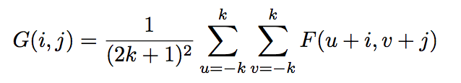
Mean filtering
0 | 0 | 0 | 0 | 0 | 0 | 0 | 0 | 0 | 0
0 | 0 | 0 | 0 | 0 | 0 | 0 | 0 | 0 | 0
0 | 0 | 0 | 90 | 90 | 90 | 90 | 90 | 0 | 0
0 | 0 | 0 | 90 | 90 | 90 | 90 | 90 | 0 | 0
0 | 0 | 0 | 90 | 90 | 90 | 90 | 90 | 0 | 0
0 | 0 | 0 | 90 | 0 | 90 | 90 | 90 | 0 | 0
0 | 0 | 0 | 90 | 90 | 90 | 90 | 90 | 0 | 0
0 | 0 | 0 | 0 | 0 | 0 | 0 | 0 | 0 | 0
0 | 0 | 90 | 0 | 0 | 0 | 0 | 0 | 0 | 0
0 | 0 | 0 | 0 | 0 | 0 | 0 | 0 | 0 | 0
 | 0
0 | 0 | 0 | 0 | 0 | 0 | 0 | 0 | 0 | 0
0 | 0 | 0 | 0 | 0 | 0 | 0 | 0 | 0 | 0
0 | 0 | 0 | 90 | 90 | 90 | 90 | 90 | 0 | 0
0 | 0 | 0 | 90 | 90 | 90 | 90 | 90 | 0 | 0
0 | 0 | 0 | 90 | 90 | 90 | 90 | 90 | 0 | 0
0 | 0 | 0 | 90 | 0 | 90 | 90 | 90 | 0 | 0
0 | 0 | 0 | 90 | 90 | 90 | 90 | 90 | 0 | 0
0 | 0 | 0 | 0 | 0 | 0 | 0 | 0 | 0 | 0
0 | 0 | 90 | 0 | 0 | 0 | 0 | 0 | 0 | 0
0 | 0 | 0 | 0 | 0 | 0 | 0 | 0 | 0 | 0
Credit: S. Seitz
Notes:
ones, divide by 9

Slide 16
Mean filtering
0 | 0 | 0 | 0 | 0 | 0 | 0 | 0 | 0 | 0
0 | 0 | 0 | 0 | 0 | 0 | 0 | 0 | 0 | 0
0 | 0 | 0 | 90 | 90 | 90 | 90 | 90 | 0 | 0
0 | 0 | 0 | 90 | 90 | 90 | 90 | 90 | 0 | 0
0 | 0 | 0 | 90 | 90 | 90 | 90 | 90 | 0 | 0
0 | 0 | 0 | 90 | 0 | 90 | 90 | 90 | 0 | 0
0 | 0 | 0 | 90 | 90 | 90 | 90 | 90 | 0 | 0
0 | 0 | 0 | 0 | 0 | 0 | 0 | 0 | 0 | 0
0 | 0 | 90 | 0 | 0 | 0 | 0 | 0 | 0 | 0
0 | 0 | 0 | 0 | 0 | 0 | 0 | 0 | 0 | 0
 | 0 | 10
0 | 0 | 0 | 0 | 0 | 0 | 0 | 0 | 0 | 0
0 | 0 | 0 | 0 | 0 | 0 | 0 | 0 | 0 | 0
0 | 0 | 0 | 90 | 90 | 90 | 90 | 90 | 0 | 0
0 | 0 | 0 | 90 | 90 | 90 | 90 | 90 | 0 | 0
0 | 0 | 0 | 90 | 90 | 90 | 90 | 90 | 0 | 0
0 | 0 | 0 | 90 | 0 | 90 | 90 | 90 | 0 | 0
0 | 0 | 0 | 90 | 90 | 90 | 90 | 90 | 0 | 0
0 | 0 | 0 | 0 | 0 | 0 | 0 | 0 | 0 | 0
0 | 0 | 90 | 0 | 0 | 0 | 0 | 0 | 0 | 0
0 | 0 | 0 | 0 | 0 | 0 | 0 | 0 | 0 | 0
Credit: S. Seitz
Notes:
ones, divide by 9

Slide 17
Mean filtering
0 | 0 | 0 | 0 | 0 | 0 | 0 | 0 | 0 | 0
0 | 0 | 0 | 0 | 0 | 0 | 0 | 0 | 0 | 0
0 | 0 | 0 | 90 | 90 | 90 | 90 | 90 | 0 | 0
0 | 0 | 0 | 90 | 90 | 90 | 90 | 90 | 0 | 0
0 | 0 | 0 | 90 | 90 | 90 | 90 | 90 | 0 | 0
0 | 0 | 0 | 90 | 0 | 90 | 90 | 90 | 0 | 0
0 | 0 | 0 | 90 | 90 | 90 | 90 | 90 | 0 | 0
0 | 0 | 0 | 0 | 0 | 0 | 0 | 0 | 0 | 0
0 | 0 | 90 | 0 | 0 | 0 | 0 | 0 | 0 | 0
0 | 0 | 0 | 0 | 0 | 0 | 0 | 0 | 0 | 0
 | 0 | 10 | 20
0 | 0 | 0 | 0 | 0 | 0 | 0 | 0 | 0 | 0
0 | 0 | 0 | 0 | 0 | 0 | 0 | 0 | 0 | 0
0 | 0 | 0 | 90 | 90 | 90 | 90 | 90 | 0 | 0
0 | 0 | 0 | 90 | 90 | 90 | 90 | 90 | 0 | 0
0 | 0 | 0 | 90 | 90 | 90 | 90 | 90 | 0 | 0
0 | 0 | 0 | 90 | 0 | 90 | 90 | 90 | 0 | 0
0 | 0 | 0 | 90 | 90 | 90 | 90 | 90 | 0 | 0
0 | 0 | 0 | 0 | 0 | 0 | 0 | 0 | 0 | 0
0 | 0 | 90 | 0 | 0 | 0 | 0 | 0 | 0 | 0
0 | 0 | 0 | 0 | 0 | 0 | 0 | 0 | 0 | 0
Credit: S. Seitz
Notes:
ones, divide by 9

Slide 18
Mean filtering
0 | 0 | 0 | 0 | 0 | 0 | 0 | 0 | 0 | 0
0 | 0 | 0 | 0 | 0 | 0 | 0 | 0 | 0 | 0
0 | 0 | 0 | 90 | 90 | 90 | 90 | 90 | 0 | 0
0 | 0 | 0 | 90 | 90 | 90 | 90 | 90 | 0 | 0
0 | 0 | 0 | 90 | 90 | 90 | 90 | 90 | 0 | 0
0 | 0 | 0 | 90 | 0 | 90 | 90 | 90 | 0 | 0
0 | 0 | 0 | 90 | 90 | 90 | 90 | 90 | 0 | 0
0 | 0 | 0 | 0 | 0 | 0 | 0 | 0 | 0 | 0
0 | 0 | 90 | 0 | 0 | 0 | 0 | 0 | 0 | 0
0 | 0 | 0 | 0 | 0 | 0 | 0 | 0 | 0 | 0
 | 0 | 10 | 20 | 30
0 | 0 | 0 | 0 | 0 | 0 | 0 | 0 | 0 | 0
0 | 0 | 0 | 0 | 0 | 0 | 0 | 0 | 0 | 0
0 | 0 | 0 | 90 | 90 | 90 | 90 | 90 | 0 | 0
0 | 0 | 0 | 90 | 90 | 90 | 90 | 90 | 0 | 0
0 | 0 | 0 | 90 | 90 | 90 | 90 | 90 | 0 | 0
0 | 0 | 0 | 90 | 0 | 90 | 90 | 90 | 0 | 0
0 | 0 | 0 | 90 | 90 | 90 | 90 | 90 | 0 | 0
0 | 0 | 0 | 0 | 0 | 0 | 0 | 0 | 0 | 0
0 | 0 | 90 | 0 | 0 | 0 | 0 | 0 | 0 | 0
0 | 0 | 0 | 0 | 0 | 0 | 0 | 0 | 0 | 0
Credit: S. Seitz
Notes:
ones, divide by 9

Slide 19
Mean filtering
0 | 0 | 0 | 0 | 0 | 0 | 0 | 0 | 0 | 0
0 | 0 | 0 | 0 | 0 | 0 | 0 | 0 | 0 | 0
0 | 0 | 0 | 90 | 90 | 90 | 90 | 90 | 0 | 0
0 | 0 | 0 | 90 | 90 | 90 | 90 | 90 | 0 | 0
0 | 0 | 0 | 90 | 90 | 90 | 90 | 90 | 0 | 0
0 | 0 | 0 | 90 | 0 | 90 | 90 | 90 | 0 | 0
0 | 0 | 0 | 90 | 90 | 90 | 90 | 90 | 0 | 0
0 | 0 | 0 | 0 | 0 | 0 | 0 | 0 | 0 | 0
0 | 0 | 90 | 0 | 0 | 0 | 0 | 0 | 0 | 0
0 | 0 | 0 | 0 | 0 | 0 | 0 | 0 | 0 | 0
 | 0 | 10 | 20 | 30 | 30
Credit: S. Seitz
Notes:
ones, divide by 9

Slide 20
Mean filtering
0 | 0 | 0 | 0 | 0 | 0 | 0 | 0 | 0 | 0
0 | 0 | 0 | 0 | 0 | 0 | 0 | 0 | 0 | 0
0 | 0 | 0 | 90 | 90 | 90 | 90 | 90 | 0 | 0
0 | 0 | 0 | 90 | 90 | 90 | 90 | 90 | 0 | 0
0 | 0 | 0 | 90 | 90 | 90 | 90 | 90 | 0 | 0
0 | 0 | 0 | 90 | 0 | 90 | 90 | 90 | 0 | 0
0 | 0 | 0 | 90 | 90 | 90 | 90 | 90 | 0 | 0
0 | 0 | 0 | 0 | 0 | 0 | 0 | 0 | 0 | 0
0 | 0 | 90 | 0 | 0 | 0 | 0 | 0 | 0 | 0
0 | 0 | 0 | 0 | 0 | 0 | 0 | 0 | 0 | 0
 | 0 | 10 | 20 | 30 | 30
?
Credit: S. Seitz
Notes:
ones, divide by 9

Slide 21
Mean filtering
0 | 0 | 0 | 0 | 0 | 0 | 0 | 0 | 0 | 0
0 | 0 | 0 | 0 | 0 | 0 | 0 | 0 | 0 | 0
0 | 0 | 0 | 90 | 90 | 90 | 90 | 90 | 0 | 0
0 | 0 | 0 | 90 | 90 | 90 | 90 | 90 | 0 | 0
0 | 0 | 0 | 90 | 90 | 90 | 90 | 90 | 0 | 0
0 | 0 | 0 | 90 | 0 | 90 | 90 | 90 | 0 | 0
0 | 0 | 0 | 90 | 90 | 90 | 90 | 90 | 0 | 0
0 | 0 | 0 | 0 | 0 | 0 | 0 | 0 | 0 | 0
0 | 0 | 90 | 0 | 0 | 0 | 0 | 0 | 0 | 0
0 | 0 | 0 | 0 | 0 | 0 | 0 | 0 | 0 | 0
 | 0 | 10 | 20 | 30 | 30
 |  |  |  | 50
?
Credit: S. Seitz
Notes:
ones, divide by 9

Slide 22
Mean filtering
Larger k => more blurring

Slide 23

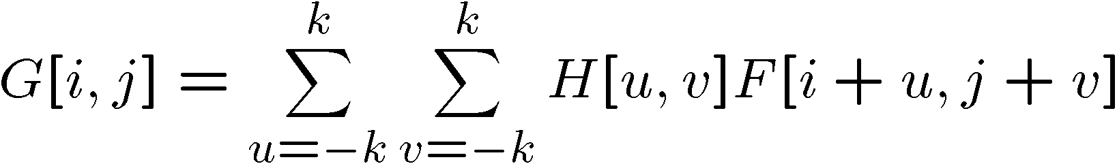
Cross-correlation
The mean filter is just a specific case of a cross-correlation, a very general operation.
Let F an image, H be a kernel (of size 2k+1 x 2k+1), then the cross-correlation of F with H is:

Slide 24
Linear filtering
More general version: linear filtering (cross-correlation, convolution)
Replace each pixel by a linear combination of its neighbors
The prescription for the linear combination is called the “kernel” (or “mask”, “filter”)
10
5
3
0
0
0
4
6
1
0
0.5
0
8
1
1
8
0
1
0.5
Local image data
kernel
Modified image data
Source: L. Zhang

Slide 25



Cross correlation
Adapted from F. Durand

Slide 26
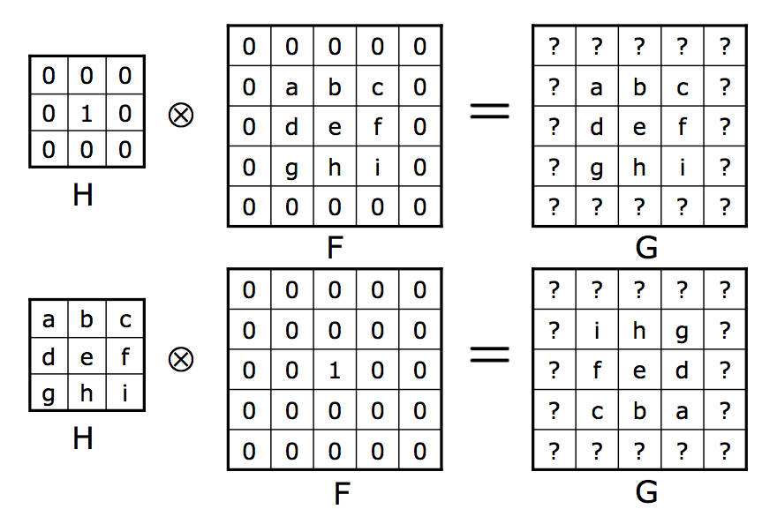
Cross-correlation examples

Slide 27

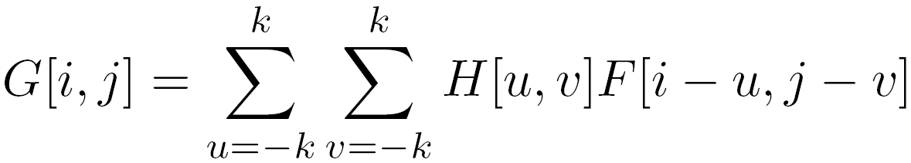
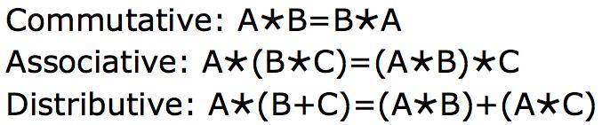
Convolution
Same as cross-correlation, except that the kernel is “flipped” (horizontally and vertically)
Commutative, associative, and transitive:

Slide 28

Convolution
Adapted from F. Durand

Slide 29
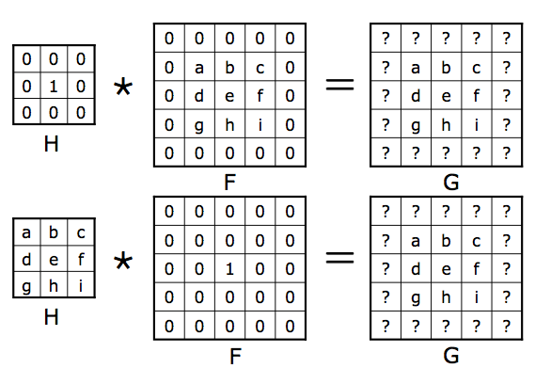
Convolution examples

Slide 30



Mean filtering
0 | 0 | 0 | 0 | 0 | 0 | 0 | 0 | 0 | 0
0 | 0 | 0 | 0 | 0 | 0 | 0 | 0 | 0 | 0
0 | 0 | 0 | 90 | 90 | 90 | 90 | 90 | 0 | 0
0 | 0 | 0 | 90 | 90 | 90 | 90 | 90 | 0 | 0
0 | 0 | 0 | 90 | 90 | 90 | 90 | 90 | 0 | 0
0 | 0 | 0 | 90 | 0 | 90 | 90 | 90 | 0 | 0
0 | 0 | 0 | 90 | 90 | 90 | 90 | 90 | 0 | 0
0 | 0 | 0 | 0 | 0 | 0 | 0 | 0 | 0 | 0
0 | 0 | 90 | 0 | 0 | 0 | 0 | 0 | 0 | 0
0 | 0 | 0 | 0 | 0 | 0 | 0 | 0 | 0 | 0
 | 0 | 10 | 20 | 30 | 30 | 30 | 20 | 10
 | 0 | 20 | 40 | 60 | 60 | 60 | 40 | 20
 | 0 | 30 | 60 | 90 | 90 | 90 | 60 | 30
 | 0 | 30 | 50 | 80 | 80 | 90 | 60 | 30
 | 0 | 30 | 50 | 80 | 80 | 90 | 60 | 30
 | 0 | 20 | 30 | 50 | 50 | 60 | 40 | 20
 | 10 | 20 | 30 | 30 | 30 | 30 | 20 | 10
 | 10 | 10 | 10 | 0 | 0 | 0 | 0 | 0
*
=
1 | 1 | 1
1 | 1 | 1
1 | 1 | 1

Slide 31
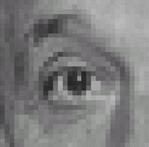
Linear filters: examples
*
0
0
0
=
0
1
0
0
0
0
Original
Identical image
Source: D. Lowe

Slide 32
Linear filters: examples
*
0
0
0
=
1
0
0
0
0
0
Original
Shifted left
By 1 pixel
Source: D. Lowe

Slide 33
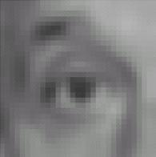

Linear filters: examples
*
1
1
1
=
1
1
1
1
1
1
Original
Blur (with a mean filter)
Source: D. Lowe

Slide 34
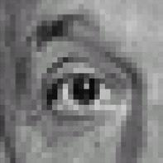



Linear filters: examples
*
0
0
0
-
1
1
1
=
0
2
0
1
1
1
0
0
0
1
1
1
Sharpening filter (accentuates edges)
Original
Source: D. Lowe

Slide 35
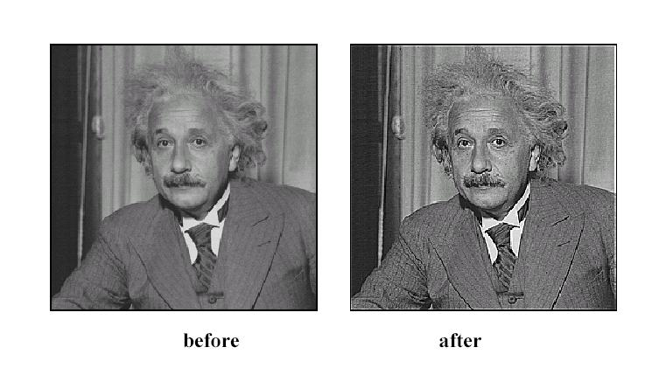
Sharpening
Source: D. Lowe

Slide 36
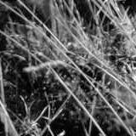
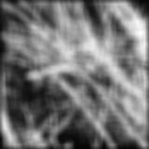
Mean filter revisited
Source: D. Forsyth
Notes:
I always walk through the argument on the left rather carefully; it gives some insight into the
significance of impulse responses or point spread functions.

Slide 37
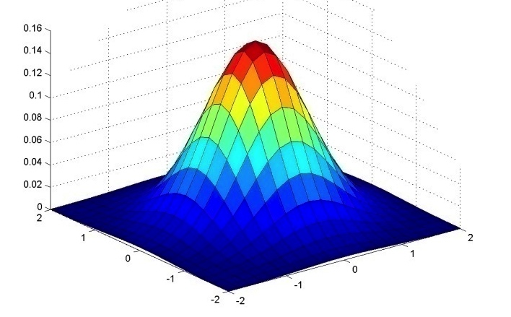
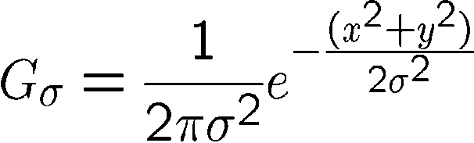
Important filter: Gaussian
Weight contributions of neighboring pixels by proximity
0.003 0.013 0.022 0.013 0.003
0.013 0.059 0.097 0.059 0.013
0.022 0.097 0.159 0.097 0.022
0.013 0.059 0.097 0.059 0.013
0.003 0.013 0.022 0.013 0.003
5 x 5, σ = 1
Slide credit: Christopher Rasmussen

Slide 38


Smoothing with Gaussian filter

Slide 39

Smoothing with box filter

Slide 40
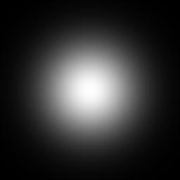

Gaussian filter
Removes “high-frequency” components from the image (low-pass filter)
Larger σ blurs more
Convolution with self is another Gaussian
=
*
Source: K. Grauman
Notes:
Linear vs. quadratic in mask size

Slide 41

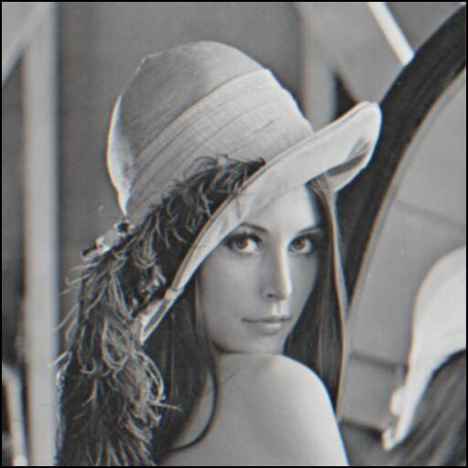
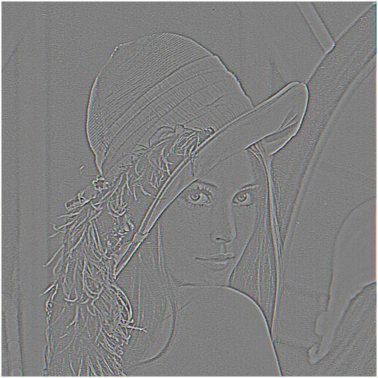

Other filtering operations
What does blurring take away?
–
=
original
smoothed (5x5)
detail
Let’s add it back:
+ α
=
original
detail
sharpened
Source: S. Lazebnik

Slide 42
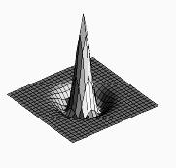

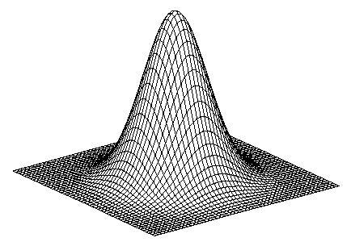
Sharpen filter
blurred image
image
unit impulse (identity)
scaled impulse
Gaussian
Laplacian of Gaussian
Notes:
f + a(f - f * g) = (1+a)f-af*g = f*((1+a)e-g)

Slide 43

Sharpen filter
unfiltered
filtered

Slide 44
Sharpening
Source: D. Lowe

Slide 45
Implementation issues
How do we handle border cases?
No good answer. Depends on the application. Reflection is often the least bad.

Slide 46
Practical matters
How big should the filter be?
Values at edges should be near zero
Rule of thumb for Gaussian: set filter half-width to about 3 σ

Slide 47
Efficient convolution
How do we implement convolution?
Naïve method: for each pixel in the image, loop over all entries of the kernel
This takes time O(n²k²). Can we do better?

Slide 48
Speeding up convolution
Separate into 1-d passes
First to each row, then to each column
Possible if the kernel is dimensionally separable (e.g. box mean filter and gaussian filter), i.e. if H=H₁ * H₂, then G = F * H = F * (H₁ * H₂) = (F * H₁) * H₂

Slide 49
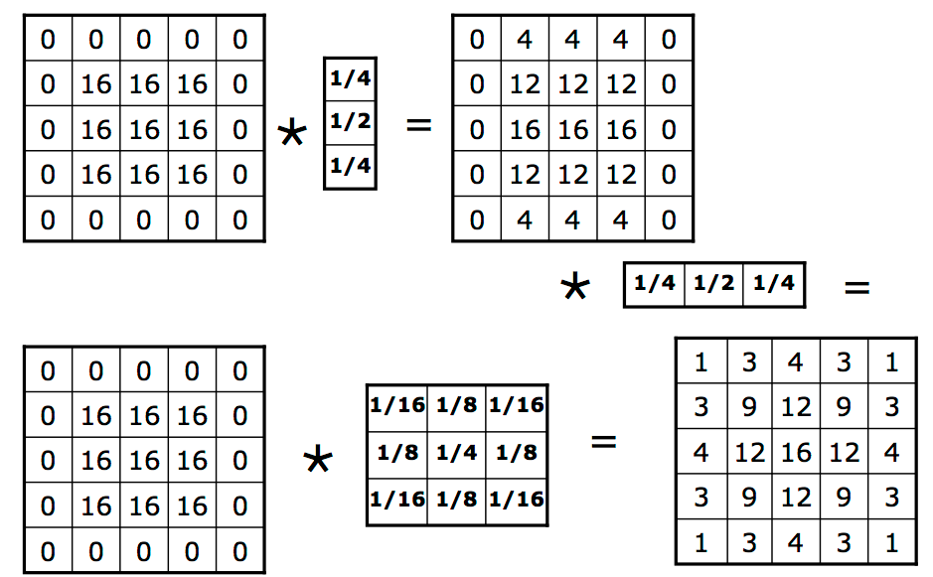

Slide 50
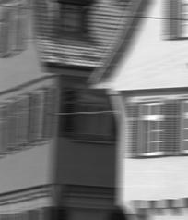
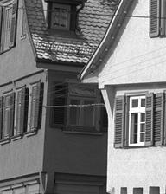
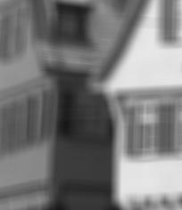
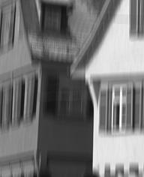

Slide 51
Speeding up convolution
For the box mean filter, we can speed up each of the 1-d passes using dynamic programming
Single 1-d pass takes O(n) time, so total running time is O(n^2)

Slide 52
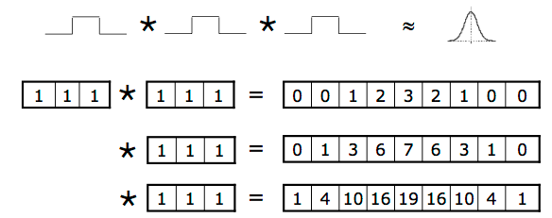
Fast Gaussian filtering
Repeated box mean filtering of an image approximates a Gaussian filter
Consequence of the central limit theorem

Slide 53
Good approximation to Gaussian
Convolution of 4 box filters of different widths yields good approximation [Wells86]
Takes O(n^2) time

